Slide 1
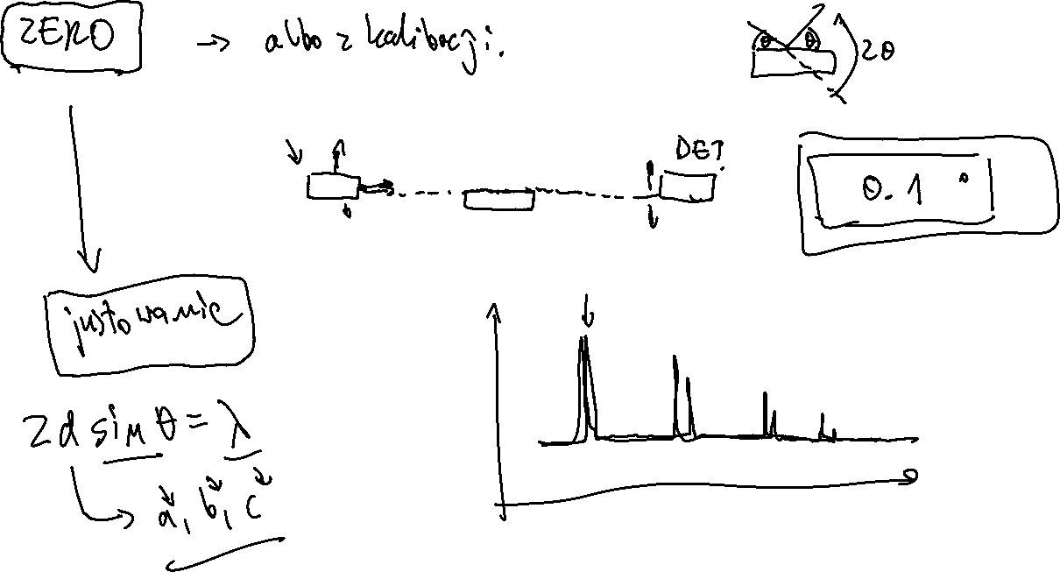

Slide 2
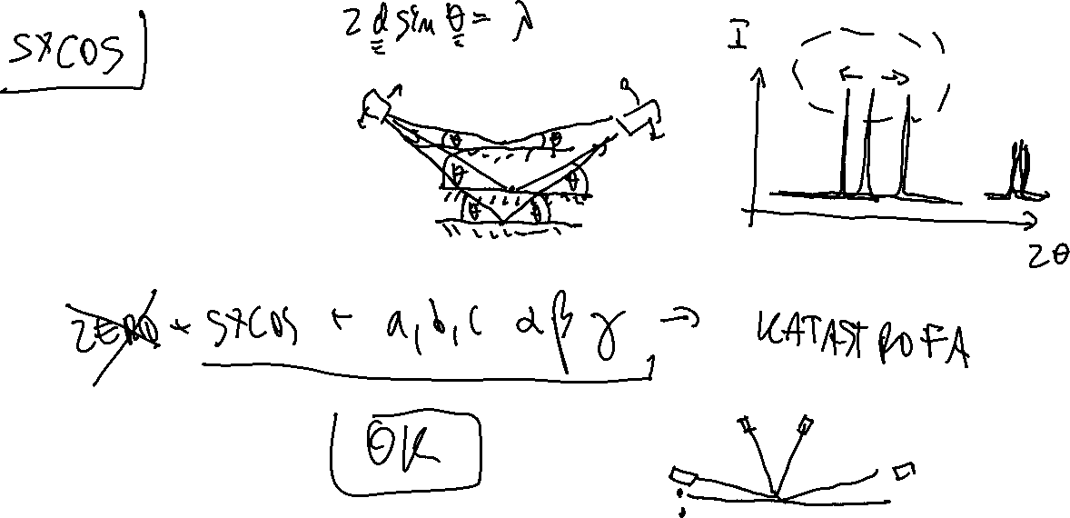

Slide 3
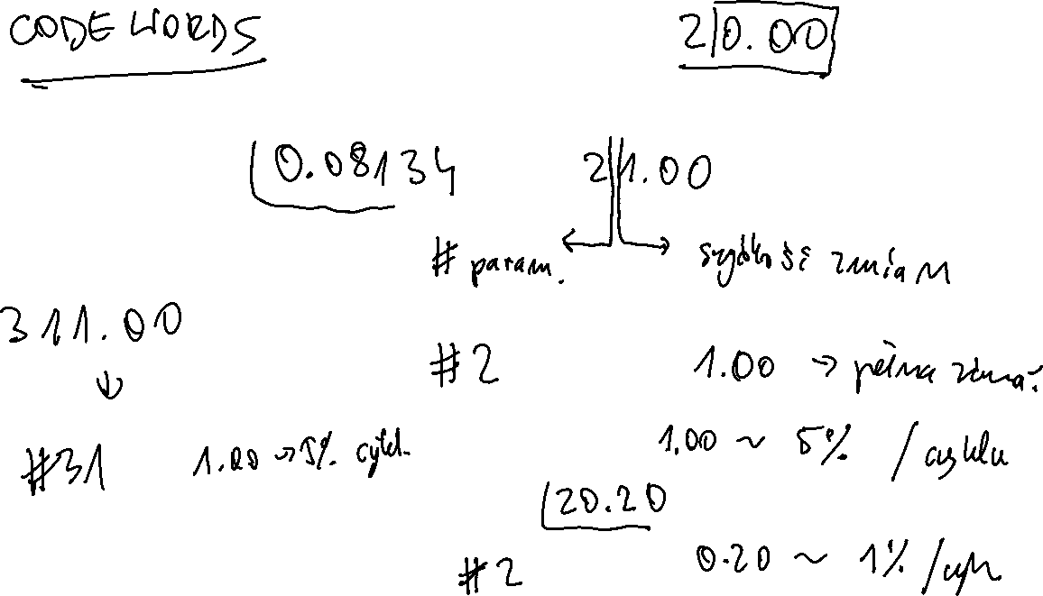

Slide 4
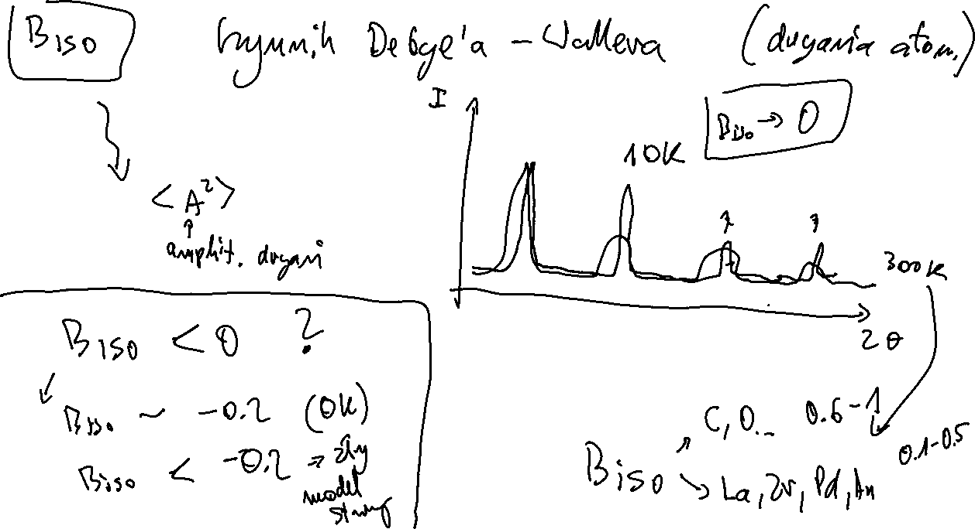

Slide 5
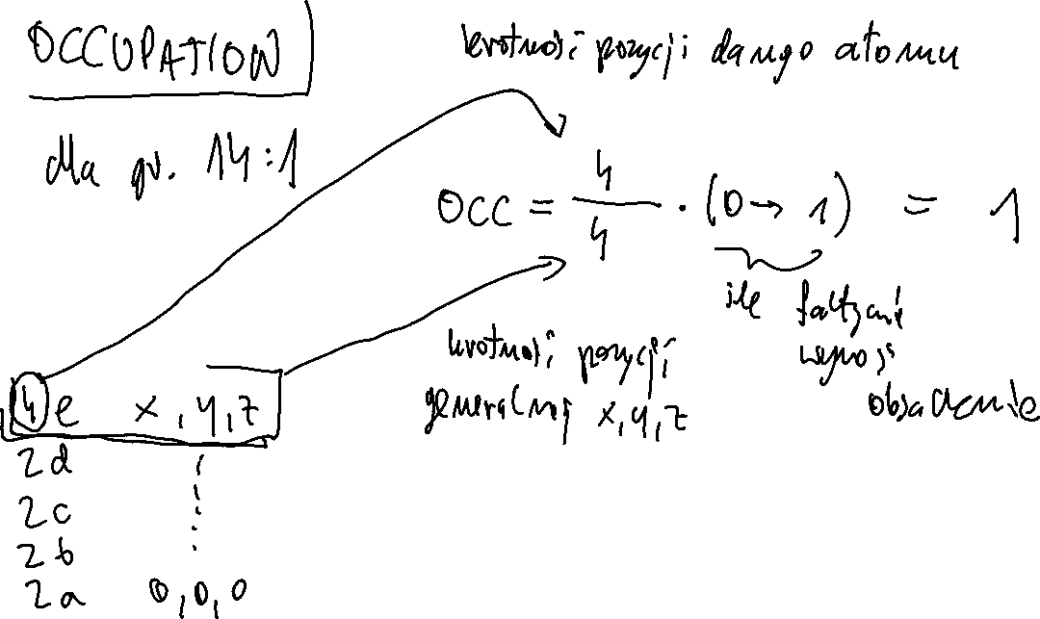

Slide 6
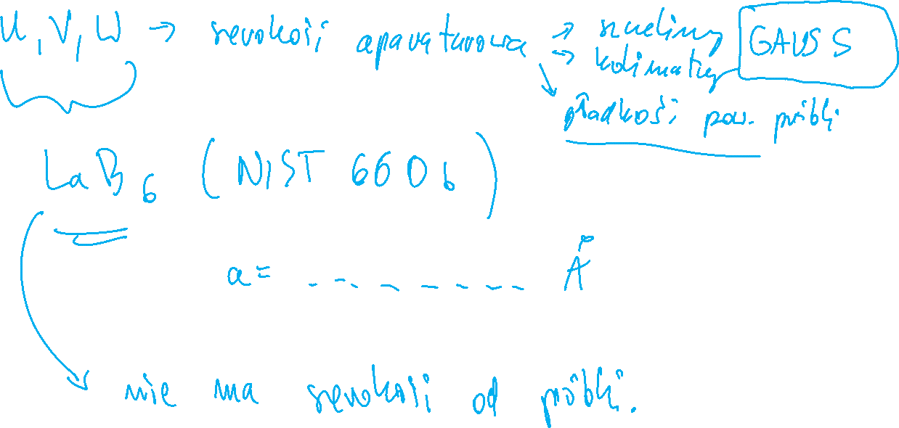

Slide 7
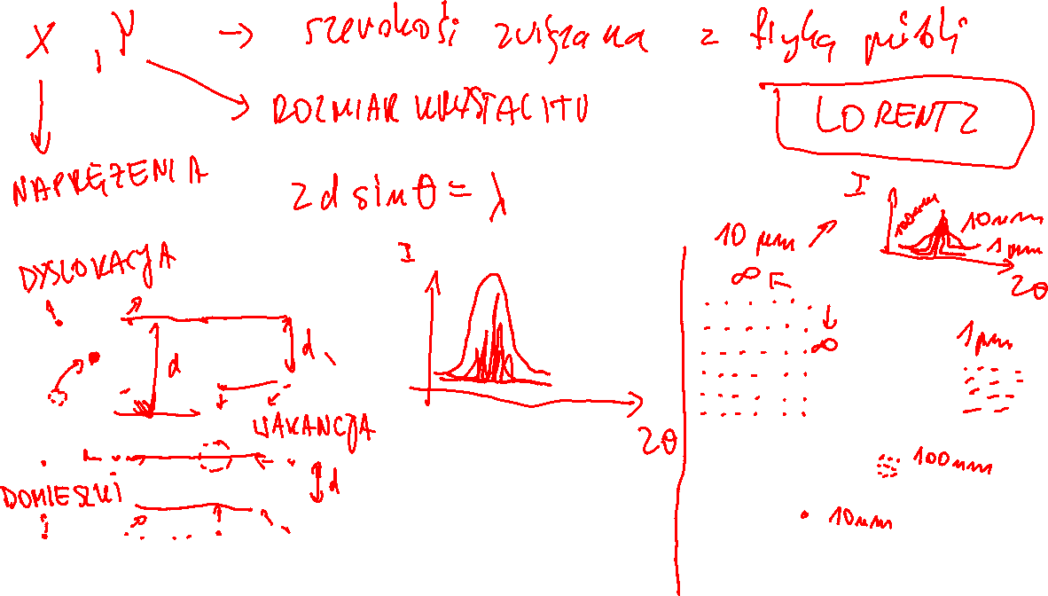

Slide 8
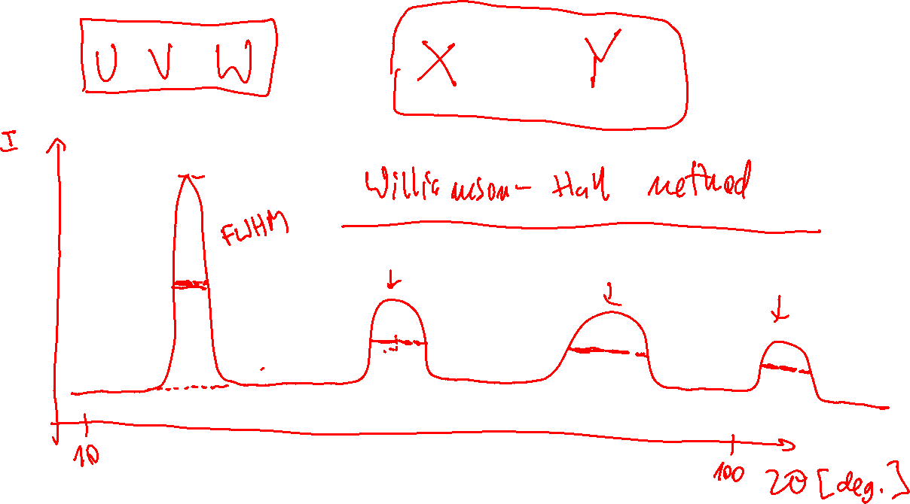

Slide 9
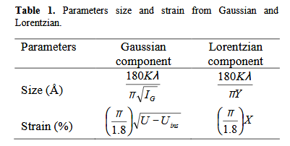
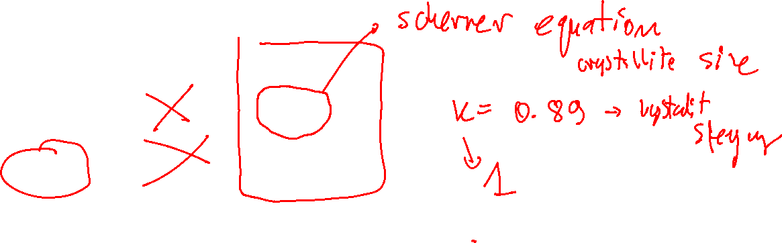

Slide 10
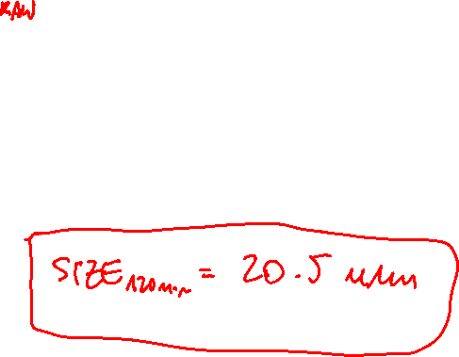
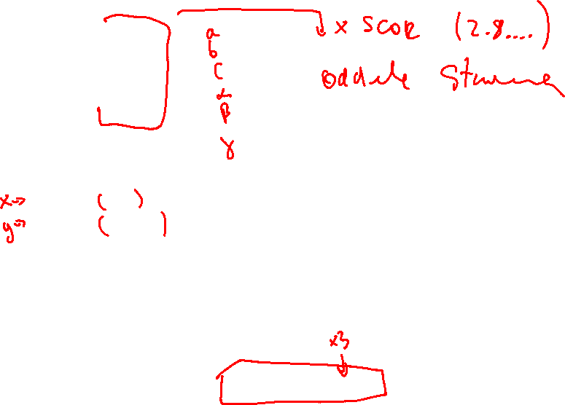
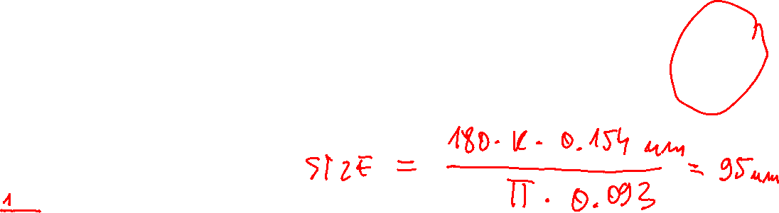
5.14715 0.00015
5.20256 0.00016
5.32006 0.00016
90.00000 0.00000
99.19052 0.00044
90.00000 0.00000
X and y parameters :
0.15400 0.01
0.09299 0.00519
-----------------------------------------------------
BRAGG R-Factors and weight fractions for Pattern # 1
-----------------------------------------------------
=> Phase: 1 ZrO2 mono
=> Bragg R-factor: 8.83 Vol: 140.634( 0.007) Fract(%): 100.00( 1.26)
=> Rf-factor= 4.75 ATZ: 492.875 Brindley: 1.0000
120 min
X and y parameters : 0.33062 0.04226
0.43074 0.02582

Slide 11
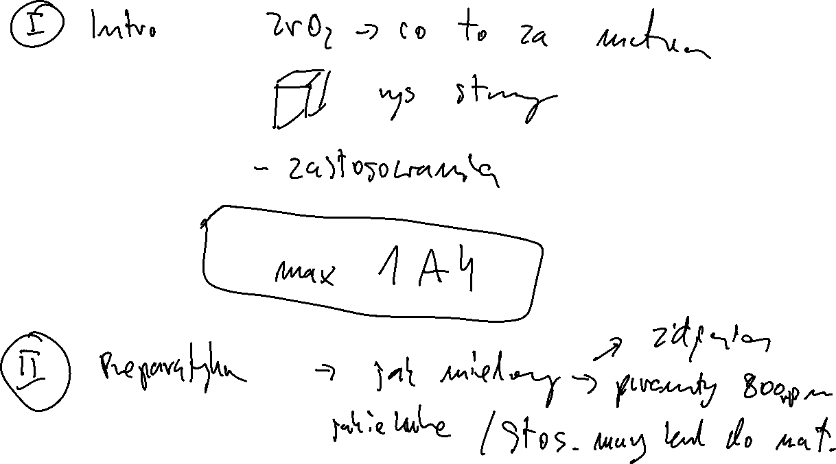

Slide 12
